Slide 1
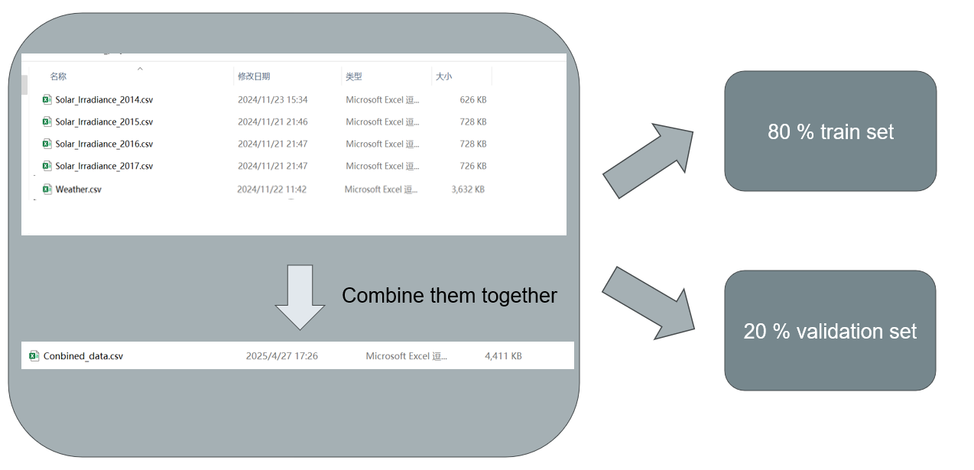
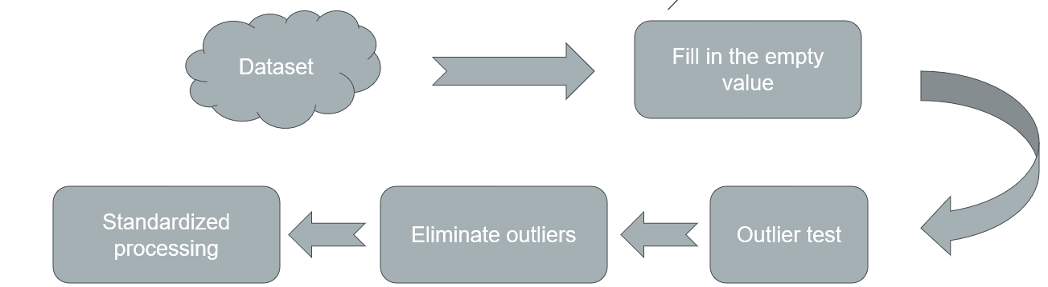
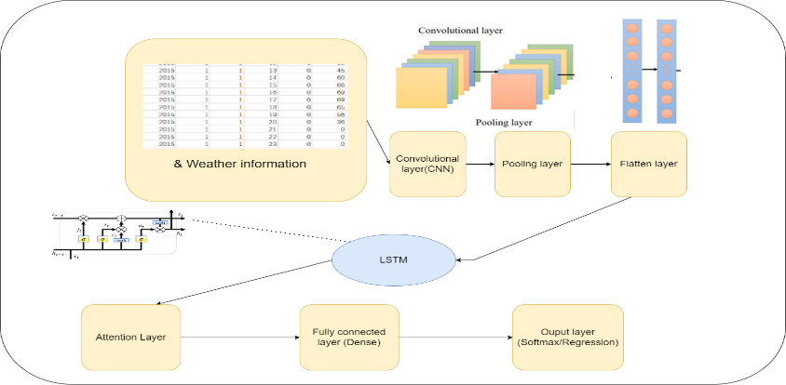
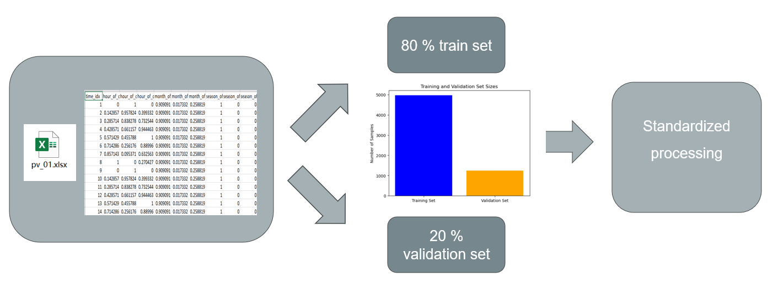
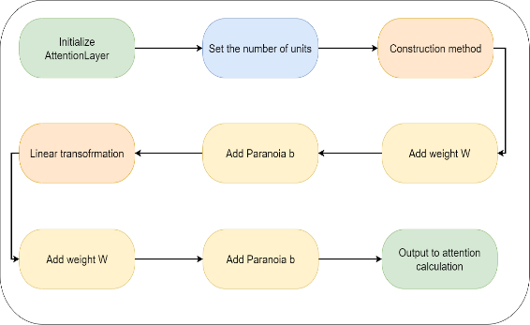
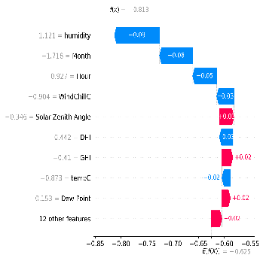
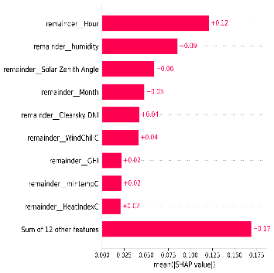
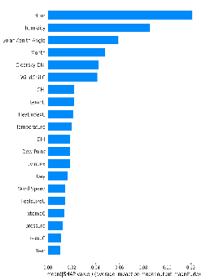
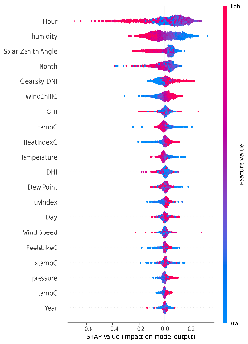
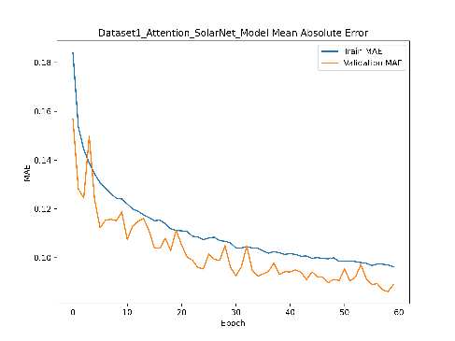
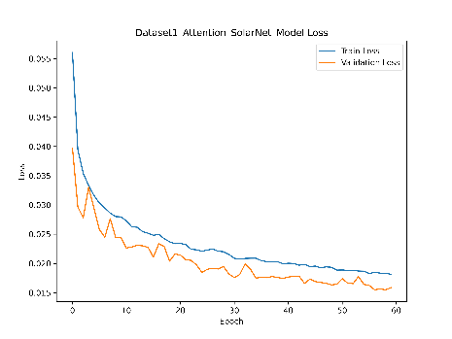
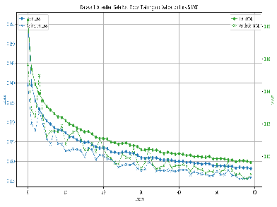
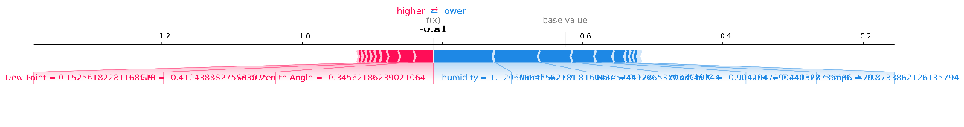
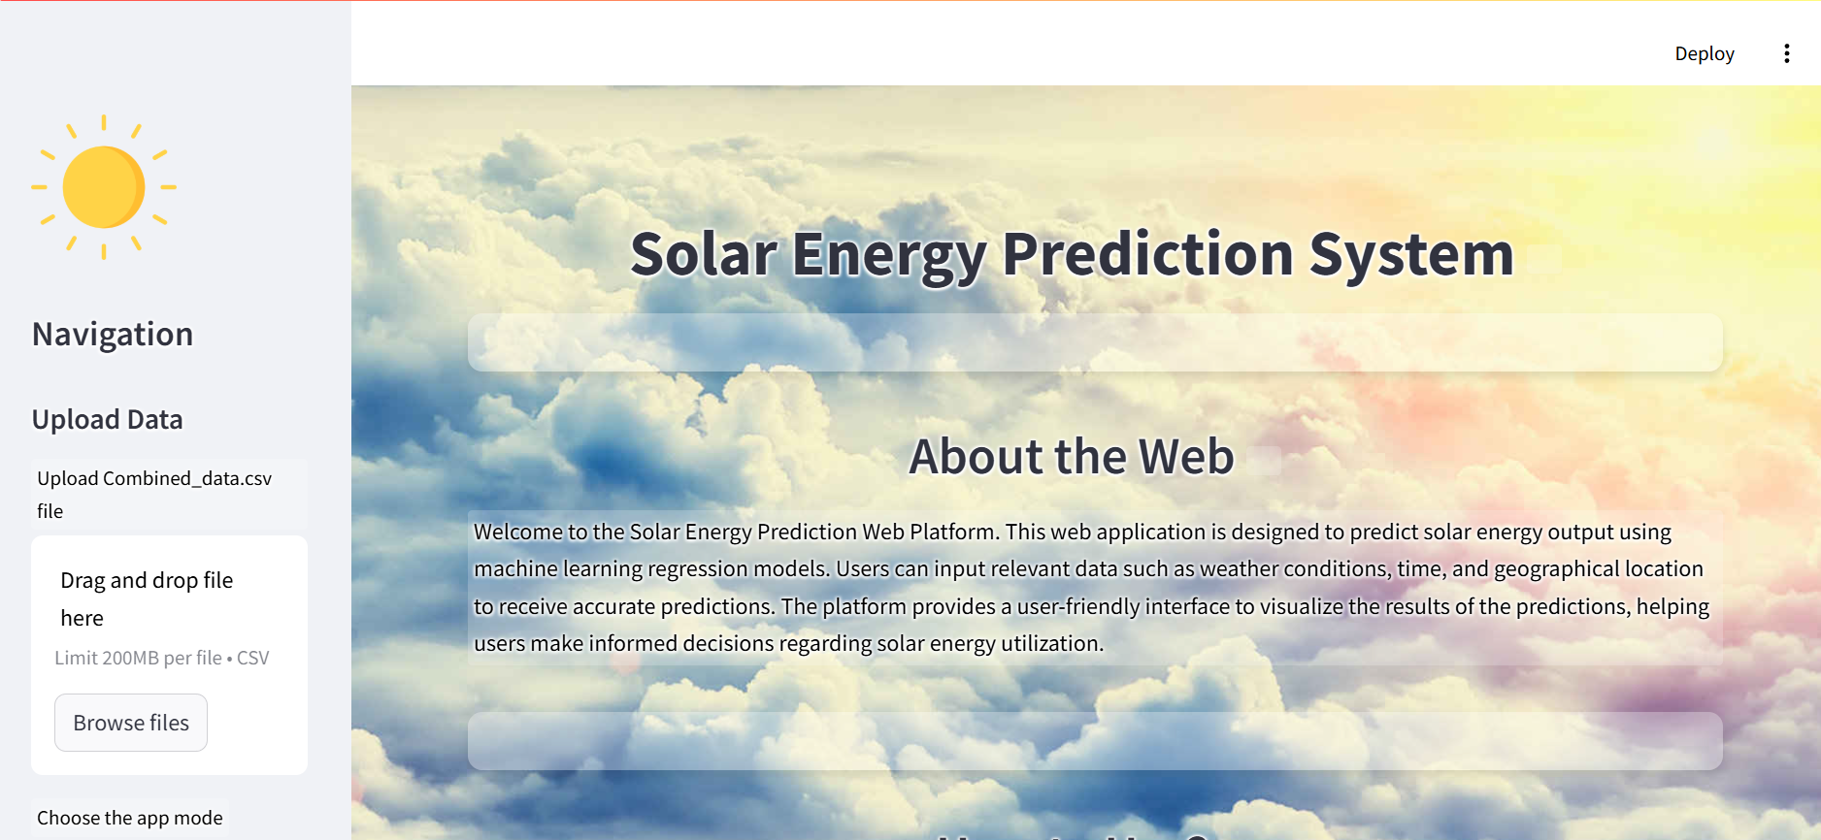
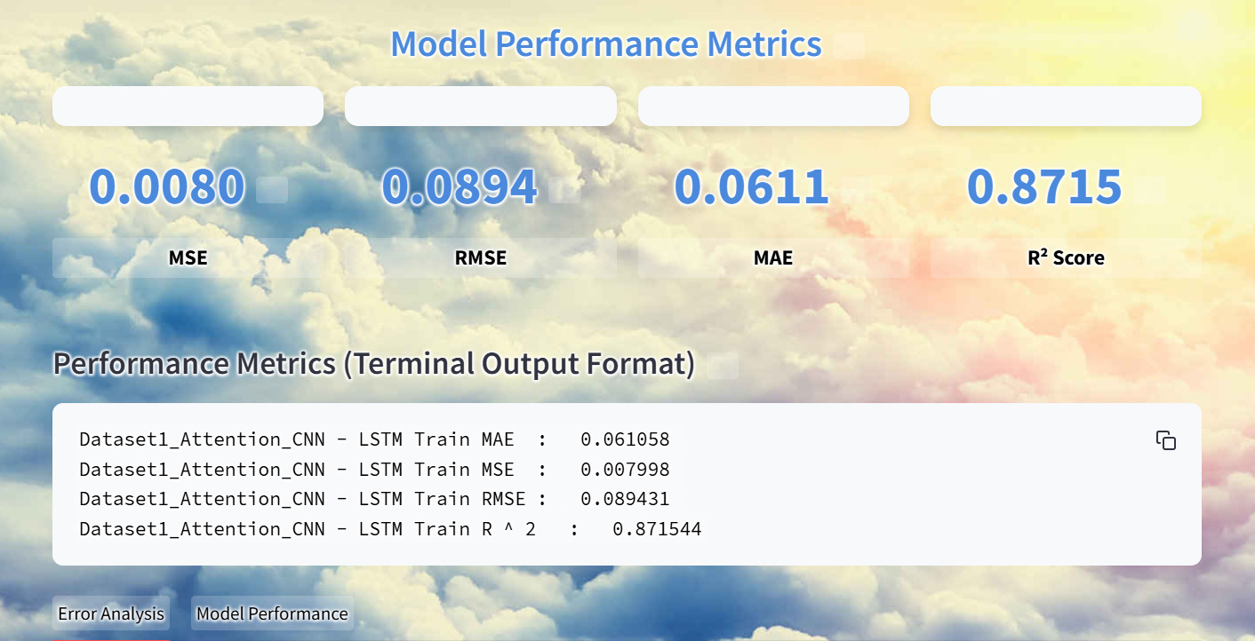
OXFORD
BROOKES
UNIVERSITY
Solar Irradiance Prediction Using Attention-SolatMeNet
Oxford Brookes University in collaboration with Chengdu University of Technology
Author: Duan Wenhui
Supervisor: Dr. Grace Ugochi Nneji
Abstract
Addressing the urgent need to reduce fossil fuel use, our project focuses on improving solar energy prediction with the Attention-SolarMeNet model. This innovative approach combines advanced feature extraction and temporal analysis to enhance accuracy.Key results from two datasets are impressive: Dataset 1 had an MAE of 0.065, MSE of 0.009, RMSE of 0.098, R² of 0.852; Dataset 2 showed an MAE of 0.039, MSE of 0.006, RMSE of 0.081, R² of 0.829. This advancement in solar prediction technology is crucial for optimizing energy management, supporting renewable energy integration, and ensuring grid stability, offering significant value to the solar industry and the environment.
Dataset 1 contains 20020 rows of solar data from 2015 to 2017, while dataset 2 records 6218 rows of environment factors.
Proposed Model
Attention-SolarMeNet
Dataset & Data Process
Figure 1: Dataset 1 processing
Figure 3: Model Overview
Figure 3 shows the architecture of Attention-SolarMeNet, which combines convolution layer, attention layer shown in Figure 4 and LSTM layer. The Attention –SolarMeNet is used capture features and time series for solar energy forecasting.
Figure 2: Dataset 2 processing
Model Explainability (SHAP)
Figure 4: Attention Architecture
To enhance model transparency and build trust, uses methods like SHAP
Result Analysis
Figure 6: MAE curve
Figure 7: Loss curve
Figure 6: Predicted value-actual value
Figure 5: SHAP Plots
Figure 6 and Figure 7 shows the MAE and Loss curve of dataset 1 and Figure 8 shows the prediction curve about predicted value and actual value
Web Deployment
Conclusion
Model development
The Attention-SolatMeNet model was successfully developed for the prediction of solar irradiance.
The model adopts deep learning techniques, especially the attention mechanism, to capture complex patterns in the data.
Performance Evaluation
Tests were conducted on two different datasets, demonstrating excellent performance.
The experimental results show lower MAE, MSE and RMSE.A relatively high R2 was obtained, proving the predictive ability of the model.
This project develops a web-based solar energy forecasting platform, which can support upload csv file to predict the solar data, and show the evaluation indicators about the model.
Reference
[1] S. M. J. Jalali, S. Ahmadian, A. Kavousi-Fard, A. Khosravi and S. Nahavandi, "Automated Deep CNN-LSTM Architecture Design for Solar Irradiance Forecasting," in IEEE Transactions on Systems, Man, and Cybernetics: Systems, vol. 52, no. 1, pp. 54-65, Jan. 2022, doi: 10.1109/TSMC.2021.3093519.
[2] S.-C. Lim, J.-H. Huh, S.-H. Hong, C.-Y. Park, and J.-C. Kim, “Solar Power Forecasting Using CNN-LSTM Hybrid Model,” Energies, vol. 15, no. 21, Art. no. 21, Jan. 2022, doi: 10.3390/en15218233.

